Slide 1

Sales Performance Dashboard
2003-2005
Muhammad Fajri Yusuf
Objective of the Analysis
Created by : Muhammad Fajri Yusuf
Source : Kaggle Dataset
Visit my
LinkedIn Here

Slide 2
Objective of the Analysis
2003-2005
Sales Performance Dashboard
Visit my
LinkedIn Here
Muhammad Fajri Yusuf
Understand sales trends over time
Identify top performing countries, products, and customers
Provide insights for potential strategic improvements.

Slide 3
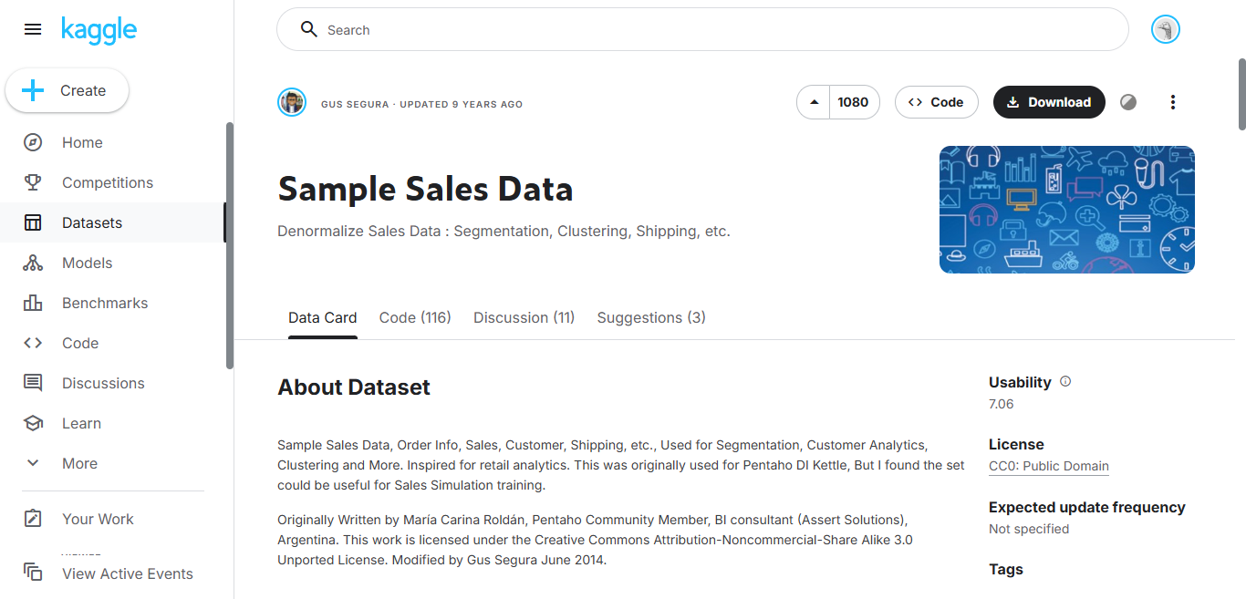
Objective of the Analysis
Sales Performance Dashboard
Visit my
LinkedIn Here
Muhammad Fajri Yusuf
Dataset Overview
Understand sales trends over time
Total Records : 2823 Records (rows)
Identify top performing countries, products, and customers
Period : 2003-2005
Understand sales trends over time
Total Columns : 25
ORDERNUMBER
QUANTITYORDERED
DATASET LINK
PRICEEACH
ORDERLINENUMBER
and 21 other columns

Slide 4
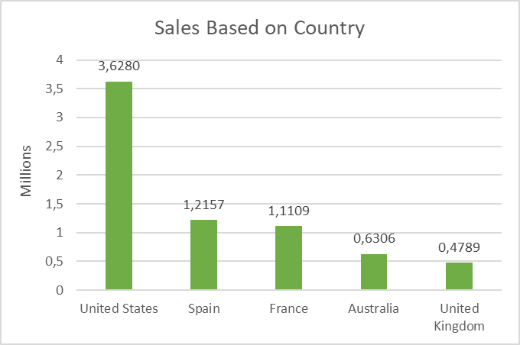
Sales Performance Dashboard
Visit my
LinkedIn Here
Muhammad Fajri Yusuf
Sales by Country
USA is the Highest Sales of all countries, Spain and France follow in second and third
USA contributes over 36% of total sales

Slide 5
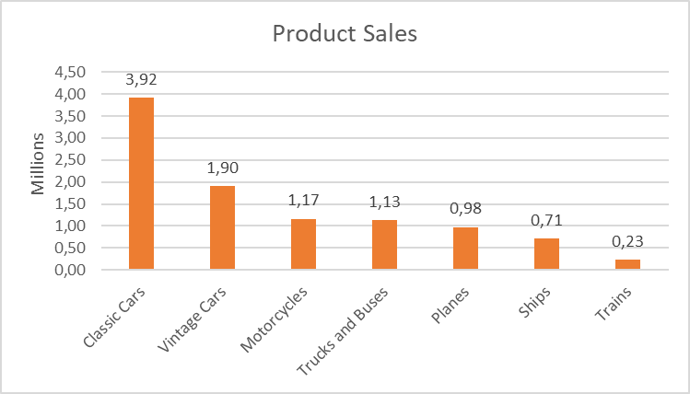
Sales Performance Dashboard
Visit my
LinkedIn Here
Muhammad Fajri Yusuf
Sales based on Product
Classic cars is the most sold category
Trains and ships are the lowest contributors

Slide 6
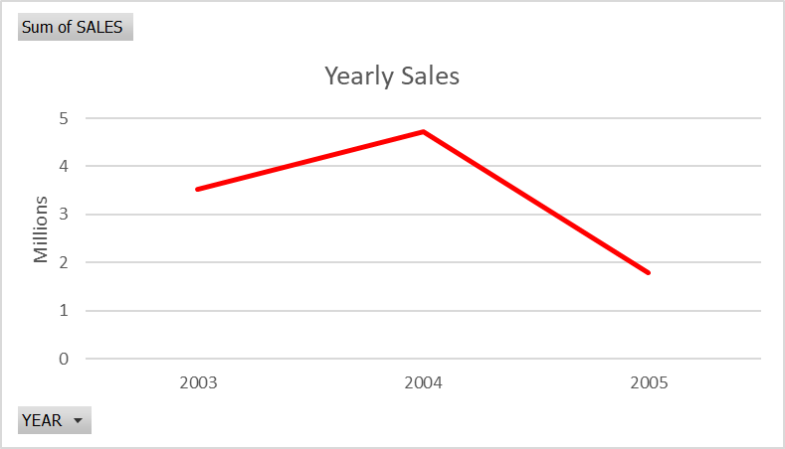
Sales Performance Dashboard
Visit my
LinkedIn Here
Muhammad Fajri Yusuf
Yearly Sales Performance
The total sales increased in 2004 compared to 2003, indicating strong business growth. However, sales dropped significantly in 2005, reflecting a sharp decline in performance after the peak in 2004.

Slide 7
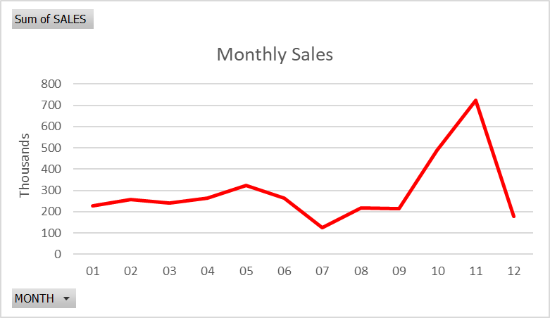
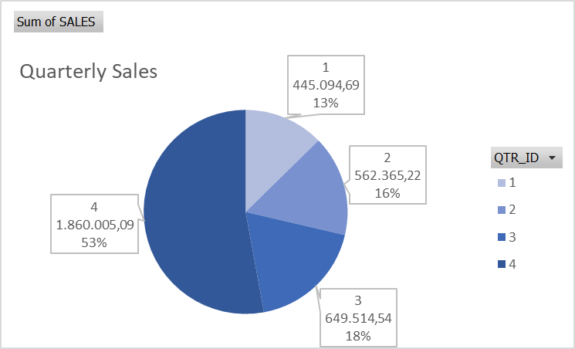
Sales Performance Dashboard
Visit my
LinkedIn Here
Muhammad Fajri Yusuf
2003 Sales Performance
Total Sales : $ 3.516.979,54
Sales peaked in November 2003 (Q4)

Slide 8
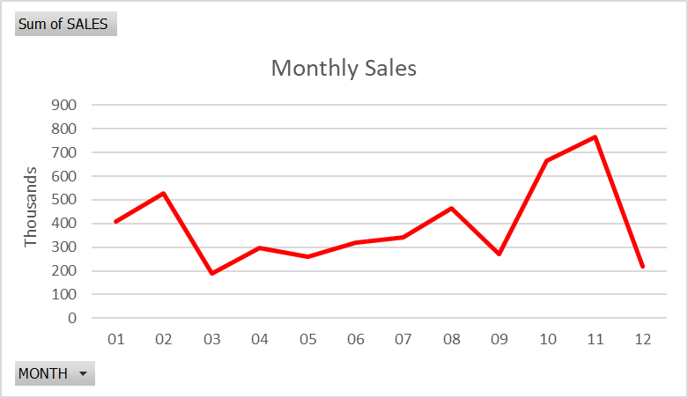
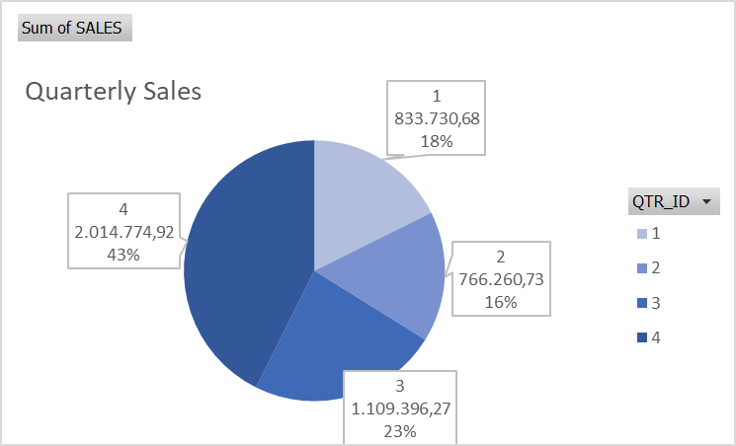
Sales Performance Dashboard
Visit my
LinkedIn Here
Muhammad Fajri Yusuf
2004 Sales Performance
Total Sales : $ 4.724.162,60
Sales peaked in November 2004 (Q4)

Slide 9
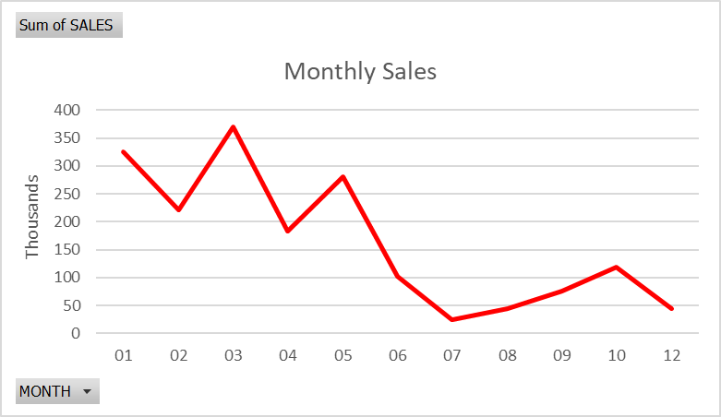
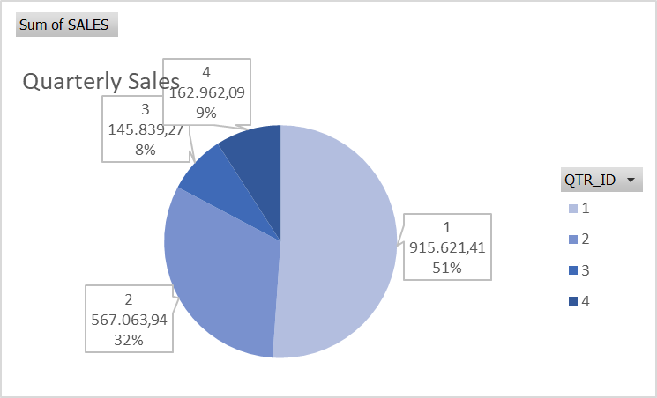
Sales Performance Dashboard
Visit my
LinkedIn Here
Muhammad Fajri Yusuf
2005 Sales Performance
Total Sales : $ 1.791.486,71
A sharp decline in 2005 indicates a loss of momentum after 2004.

Slide 10
Sales Performance Dashboard
Visit my
LinkedIn Here
Muhammad Fajri Yusuf
Insight Conclusion
Over the three-year period (2003–2005), sales showed a strong upward trend in 2004 but experienced a significant decline in 2005.
Each year, Q4 consistently generated the highest sales, with November often marking the peak month. This indicates a recurring seasonal trend, likely driven by end-of-year demand or promotional campaigns. However, the sharp drop in 2005 signals a potential issue, such as market saturation, reduced promotional effectiveness, or internal inefficiencies.

Slide 11
Sales Performance Dashboard
Visit my
LinkedIn Here
Muhammad Fajri Yusuf
Business Plan Suggestion
Enhance Q4 Campaigns Strategically
Capitalize on the strong year-end performance by planning targeted promotions, bundling offers, or loyalty programs starting in Q3.
Investigate 2005 Sales Drop
Conduct a root cause analysis to understand the sharp decline in 2005, examine factors like product availability, competition, pricing, and customer behavior.
Diversify Sales Channels & Seasons
Explore opportunities to boost sales in weaker quarters (Q1–Q3), such as launching mid-year campaigns or seasonal offers tied to local events.

Slide 12
Sales Performance Dashboard
Visit my
LinkedIn Here
Muhammad Fajri Yusuf
Thank You
Business Plan Suggestion
Data-Driven Forecasting & Inventory Planning
Use historical data trends to forecast demand and optimize stock levels, especially for high-performing periods like Q4.
This is just the beginning, more projects to be released soon.
Strengthen Customer Engagement
Invest in CRM and email marketing tools to maintain engagement throughout the year, reducing dependency on a single quarter.

Slide 13
Thank You
This is just the beginning, more projects to be released soon.
Visit my
LinkedIn Here
Muhammad Fajri Yusuf

